Slide 1
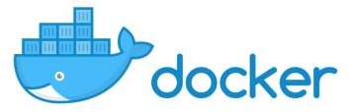
Introduction

Slide 2
What is Docker ?
Docker is an open platform for developing, shipping, and running applications.
Docker enables us to separate your applications from your infrastructure so we can deliver software quickly.

Slide 3
What can I use Docker for?
Fast, consistent delivery of your applications
Responsive deployment and scaling
Running more workloads on the same hardware

Slide 4
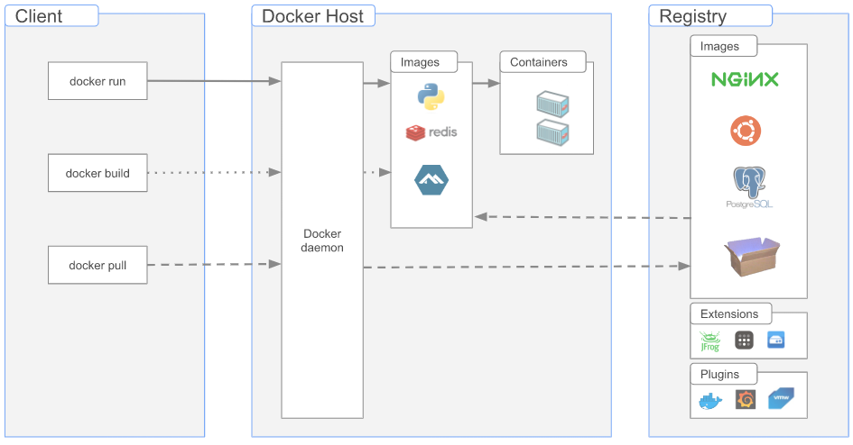
Docker architecture
Docker uses a client-server architecture.
The Docker client talks to the Docker daemon, which does the heavy lifting of building, running, and distributing your Docker containers.

Slide 5
What is Docker ?
Docker is an open platform for developing, shipping, and running applications.
Docker enables us to separate your applications from your infrastructure so we can deliver software quickly.

Slide 6
What is Docker ?
Docker is an open platform for developing, shipping, and running applications.
Docker enables us to separate your applications from your infrastructure so we can deliver software quickly.

Slide 7
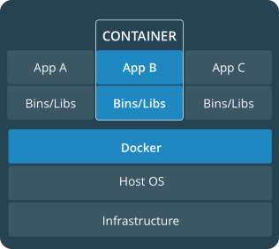
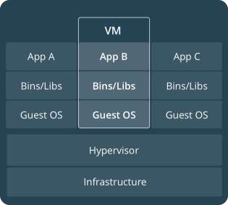
Comparing Containers and VMs
Containers are an app level construct
VMs are an infrastructure level construct to turn one machine into many servers

Slide 8





Docker Basics
Image
The basis of a Docker container. The content at rest.
Container
The image when it is ‘running.’ The standard unit for app service
Engine
The software that executes commands for containers. Networking and volumes are part of Engine. Can be clustered together.
Registry
Stores, distributes and manages Docker images
Control Plane
Management plane for container and cluster orchestration

Slide 9
What is an image?
An image is a read-only template with instructions for creating a Docker container.
In simple words, consider it like an OS Image copy (analogus with Windows/Ubuntu DVD, CD etc.) with some customization.
Often, an image is based on another image, with some additional customization. For example, you may build an image which is based on the ubuntu image, but installs the Apache web server and your application, as well as the configuration details needed to make your application run.
You might create your own images also and publish for world.

Slide 10
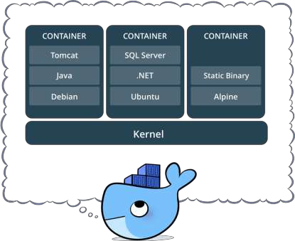
What is a container?
The image when it is ‘running’ or in action.
Standardized packaging for software and dependencies
Isolate apps from each other
Share the same OS kernel
Works with all major Linux and Windows Server

Slide 11
Key Benefits of Docker Containers
Speed
No OS to boot = applications online in seconds
Portability
Less dependencies between process layers = ability to move between infrastructure
Efficiency
Less OS overhead
Improved VM
density

Slide 12
Docker registry
A Docker registry is a storage and distribution system for named Docker images. The same image might have multiple different versions, identified by their tags.
A Docker registry is organized into Docker repositories , where a repository holds all the versions of a specific image. The registry allows Docker users to pull images locally, as well as push new images to the registry (given adequate access permissions when applicable).
By default, the Docker engine interacts with DockerHub , Docker’s public registry instance. However, it is possible to run on-premise the open-source Docker registry/distribution, as well as a commercially supported version called Docker Trusted Registry .

Slide 13
Docker run
One of the first and most important commands Docker users learn is the docker run command. This comes as no surprise since its primary function is to build and run containers.
There are many different ways to run a container. By adding attributes to the basic syntax, you can configure a container to run in detached mode, set a container name, mount a volume, and perform many more tasks.
docker run [OPTIONS] IMAGE [COMMAND] [ARG...]

Slide 14
Docker run
> docker run hello-world
Unable to find image 'hello-world:latest' locally
latest: Pulling from library/hello-world
[...]
Status: Downloaded newer image for hello-world:latest
Hello from Docker!
This message shows that your installation appears to be working correctly.
[...]

Slide 15
Docker file
A Dockerfile is simply a text-based file with no file extension that contains a script of instructions. Docker uses this script to build a container image.
A Dockerfile is a simple text file that contains a list of commands that the Docker client calls while creating an image. It's a simple way to automate the image creation process. The commands you write in a Dockerfile are almost identical to their equivalent Linux commands: this means you don't really have to learn new syntax to create your own dockerfiles.

Slide 16
Docker file directives
FROM
The from directive is used to set base image for the subsequent instructions. A Dockerfile must have FROM directive with valid image name as the first instruction.
FROM ubuntu:20.04
RUN
Using RUN directing ,you can run any command to image during build time. For example you can install required packages during the build of image.
RUN apt-get update
RUN apt-get install -y apache2 automake build-essential curl
COPY
The COPY directive used for copying files and directories from host system to the image during build. For example the first commands will copy all the files from hosts html/ directory /var/www/html image directory.
COPY html/* /var/www/html/
WORKDIR
The WORKDIR directive used to sets the working directory for any RUN, CMD, ENTRYPOINT, COPY and ADD commands during build.
WORKDIR /opt

Slide 17
Docker file directives
CMD
The CMD directive is used to run the service or software contained by your image, along with any arguments during the launching the container. CMD uses following basic syntax :
CMD ["executable","param1","param2"] For example, to start Apache service during launch of container, Use the following command : CMD ["apachectl", "-D", "FOREGROUND"]
EXPOSE
The EXPOSE directive indicates the ports on which a container will listen for the connections. After that you can bind host system port with container and use them.
EXPOSE 80 or EXPOSE 443
ENV
The ENV directive is used to set environment variable for specific service of container.
ENV PATH=$PATH:/usr/local/pgsql/bin/
ENV PG_MAJOR=9.6.0
VOLUME
The VOLUME directive creates a mount point with the specified name and marks it as holding externally mounted volumes from native host or other containers.
VOLUME ["/data"]

Slide 18
Sample docker file
Given this Dockerfile:
# syntax=docker/dockerfile:1
FROM python:3.8-slim-buster WORKDIR /python-docker COPY requirements.txt requirements.txt
RUN pip3 install -r requirements.txt COPY . . CMD [ "python3", "-m" , "flask", "run", "--host=0.0.0.0"]

Slide 19
Docker build / push
Use Docker build to build your image locally
docker build -t <registry>/<image name>:<tag> .
And Docker push to publish your image on registry
docker push <registry>/<image name>:<tag>

Slide 20
Data persistence

Slide 21
Data persistence
Docker containers provide you with a writable layer on top to make changes to your running container. But these changes are bound to the container’s lifecycle: If the container is deleted (not stopped), you lose your changes.
Let’s take a hypothetical scenario where you are running a database in a container without any data persistence configured. You create some tables and add some rows to them: but, if some reason, you need to delete this container, as soon as the container is deleted all your tables and their corresponding data get lost.
Docker provides us with a couple of solutions to persist your data even if the container is deleted. The two possible ways to persist your data are:
Bind Mounts
Volumes

Slide 22
Bind mounts
Bind mounts have been around since the early days of Docker. When you use a bind mount, a file or directory on the host machine is mounted into a container. The file or directory is referenced by its absolute path on the host machine.
By contrast, when you use a volume, a new directory is created within Docker’s storage directory on the host machine, and Docker manages that directory’s contents.
The file or directory does not need to exist on the Docker host already. It is created on demand if it does not yet exist. Bind mounts are very performant, but they rely on the host machine’s filesystem having a specific directory structure available. If you are developing new Docker applications, consider using named volumes instead.

Slide 23
Docker volumes
Volumes are the preferred mechanism for persisting data generated by and used by Docker containers. While bind mounts are dependent on the directory structure and OS of the host machine, volumes are completely managed by Docker. Volumes have several advantages over bind mounts:
Volumes are easier to back up or migrate than bind mounts.
You can manage volumes using Docker CLI commands or the Docker API.
Volumes work on both Linux and Windows containers.
Volumes can be more safely shared among multiple containers.
Volume drivers let you store volumes on remote hosts or cloud providers, to encrypt the contents of volumes, or to add other functionality.
New volumes can have their content pre-populated by a container.

Slide 24
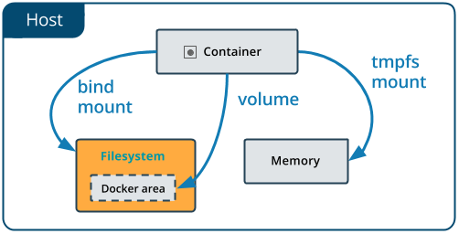
Bind mounts vs volumes

Slide 25
Docker volumes
> docker volume create my-volume
> docker run -d --name test -v my-volume:/app nginx:latest

Slide 26
Docker networking

Slide 27
Docker network basics
Docker Networking is used to connect docker container with each other and with the outside world.
Docker uses CNM (Container Network Model) for networking.
This model standardizes the steps required to provide networking for containers using multiple network drivers.

Slide 28
Docker cheatsheet

Slide 29
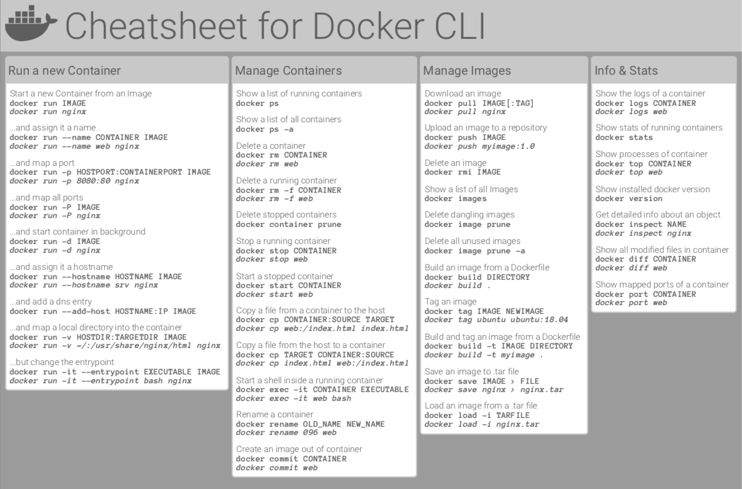

Slide 30
Docker ecosytems

Slide 31
Docker compose
Docker Compose is a tool that was developed to help define and share multi-container applications. With Compose, we can create a YAML file to define the services and with a single command, can spin everything up or tear it all down.
Each of the containers here run in isolation but can interact with each other when required.
Docker Compose files are very easy to write in a scripting language called YAML, which is an XML-based language that stands for Yet Another Markup Language.

Slide 32
version: "3.7"
services:
app:
image: node:12-alpine
command: sh -c "yarn install && yarn run dev"
ports:
- 3000:3000
working_dir: /app
volumes:
- ./:/app
environment:
MYSQL_HOST: mysql
MYSQL_USER: root
MYSQL_PASSWORD: secret
MYSQL_DB: todos
mysql:
image: mysql:5.7
volumes:
- mysql-data:/var/lib/mysql
environment:
MYSQL_ROOT_PASSWORD: secret
MYSQL_DATABASE: todos
volumes:
mysql-data:

Slide 33
Docker orchestration

Slide 34
Docker swarm
Docker swarm is a container orchestration tool, meaning that it allows the user to manage multiple containers deployed across multiple host machines.
A Docker Swarm is a group of either physical or virtual machines that are running the Docker application and that have been configured to join together in a cluster. Once a group of machines have been clustered together, you can still run the Docker commands that you're used to, but they will now be carried out by the machines in your cluster. The activities of the cluster are controlled by a swarm manager, and machines that have joined the cluster are referred to as nodes.

Slide 35
Kubernetes
Kubernetes is an open source system to deploy, scale, and manage containerized applications.
It automates operational tasks of container management and includes built-in commands for deploying applications, rolling out changes to your applications, scaling your applications up and down to fit changing needs, monitoring your applications, and more.
Application developers, IT system administrators and DevOps engineers use Kubernetes to automatically deploy, scale, maintain, schedule and operate multiple application containers across clusters of nodes.
Containers run on top of a common shared operating system (OS) on host machines but are isolated from each other unless a user chooses to connect them.

Slide 36
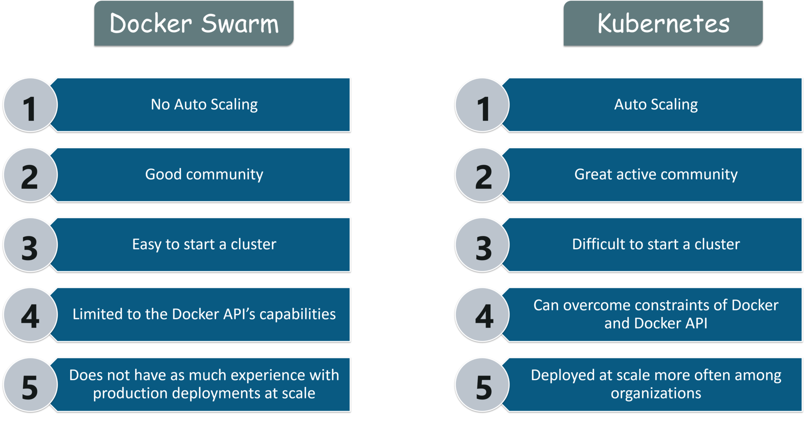

Slide 37
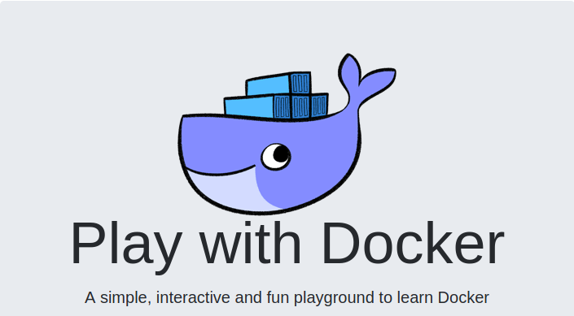
Docker playground
https://www.docker.com/play-with-docker/

